Slide 1
Class Relationships Now
Screen
Composite Object containing models
ConnectFourBoard
Disk
Button
TextBox
ConnectFourGUI
View Class in charge of what the user sees
Instantiates one Screen object
Main
Controller class in charge of user interaction
Notes:
20 seconds

Slide 2
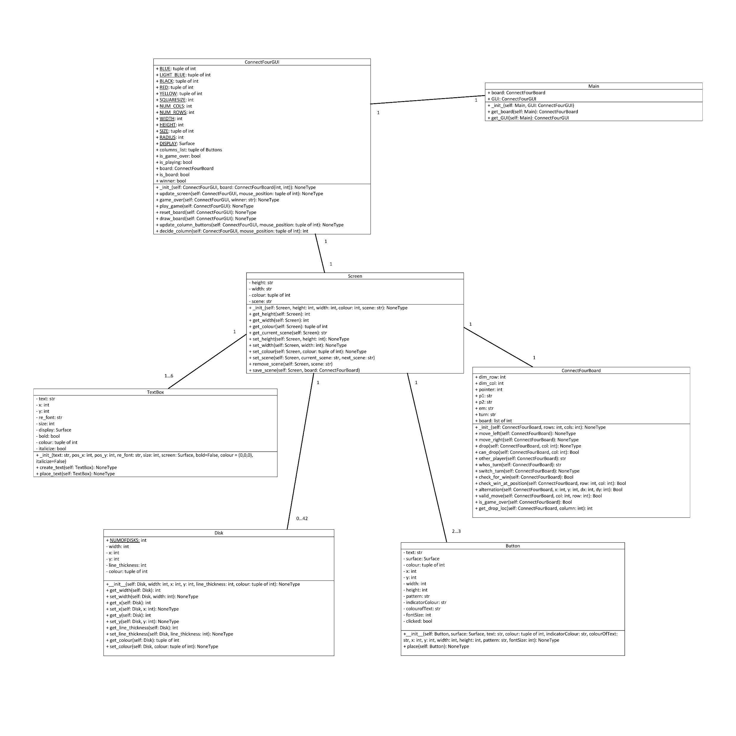
Notes:
70 seconds

